Slide 1

Artificial Intelligence application rules
Problem to solve
Variables that define it
For example: X, Y
Diabetes: Disease progression
Different Simple Learning Machines
Underfitting
Overfitting

Slide 2
Artificial Intelligence application rules
----------------------------------------------------
Definition or the topic to be studied
Obtaining information on the topic
Building a Machine that has the potential to learn about the topic
The Machine is learning about the topic
The Machine makes predictions

Slide 3
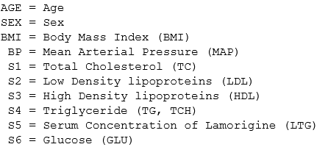
Definition or the topic to be studied
Mortalidad por diabetes
La respuesta de interés, Y, es una medida cuantitativa
de la progresión de la enfermedad un año
después del inicio del estudio
Rasgos que caracterizan esta enfermedad

Slide 4
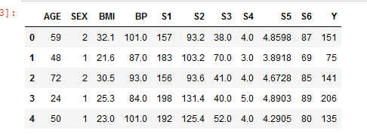

Obtaining information on the topic

Slide 5

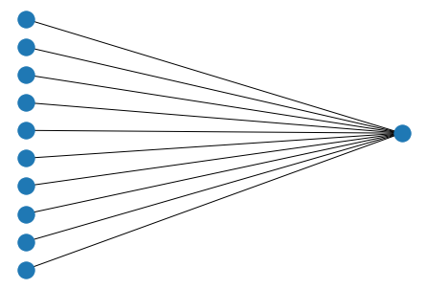

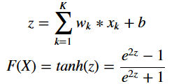
Machine 1
Lineal model
Machine 2
Non-lineal model
Notes:
5

Slide 6
The Difference Between Learning vs Training
Create educational content that truly makes a difference and does more than just exist!
In an effort to better understand the difference between learning vs training, let’s play a quick matching activity. Would you associate the following situations with “learning” or “training”?
Susan’s job performance improved after she attended a conference on industry trends.
67 employees completed their company’s annual biohazards compliance course.
Alan is now able to overcome customers’ common objections because he has gained experience in doing so successfully after several months on the job.
Lupe created an eLearning course to educate other employees on the features of their company’s new product.
Situation 1 is a clear example of learning; Susan participated in a formal learning experience and was able to apply new knowledge on the job and improve her performance afterwards. Situation 2 shows training; all we know is how many people completed the course. What we don’t know is how effective it was. Situation 3 brings us back to learning; like Susan, through informal, on-the-job experiences Alan has learned how to achieve his performance goals.
Situation 4 is not as straightforward as the others. Lupe created a training course, but ideally her intention is for the other employees to learn.

Slide 7
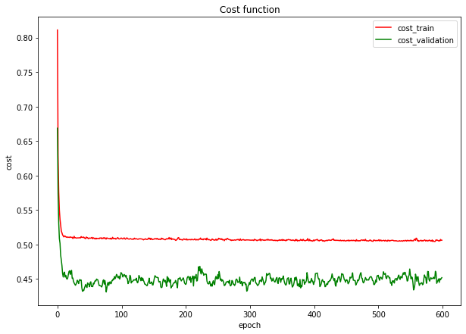
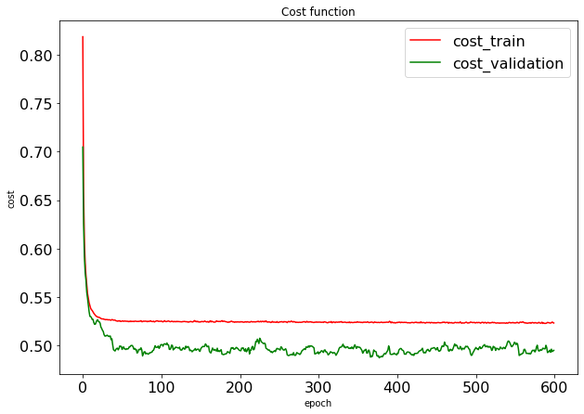
During learning
Underfitting
High bias
During learning
Underfitting

Slide 8
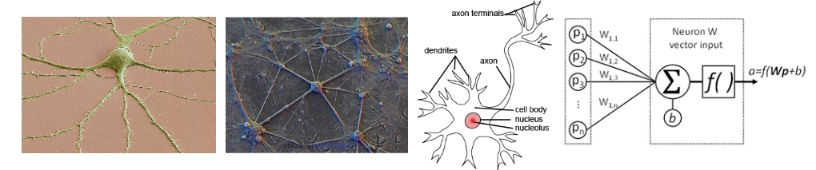
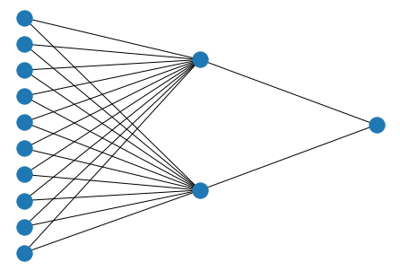
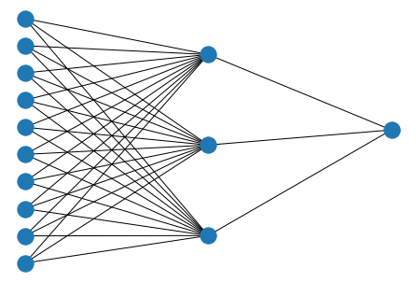
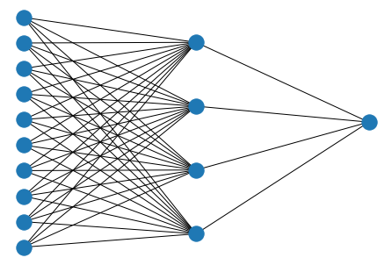
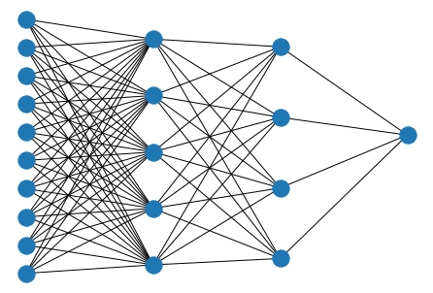
Approximation by Superpositions of a Sigmoidal Function
Approximation Capabilities of Multilayer Feedforward Networks

Slide 9
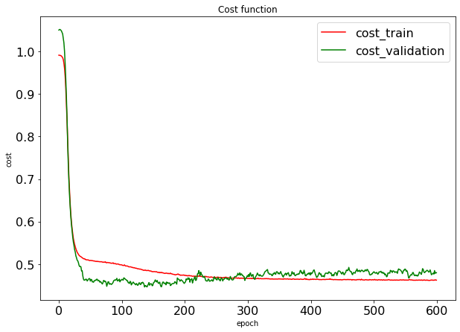
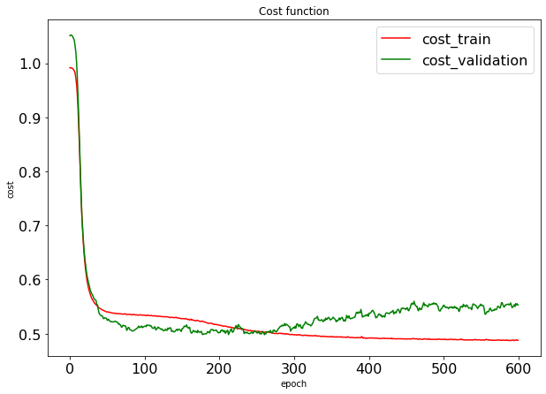
Machine 3
During learning
Lineal model output
Machine 4
During learning
Overfitting
Non-lineal model output

Slide 10
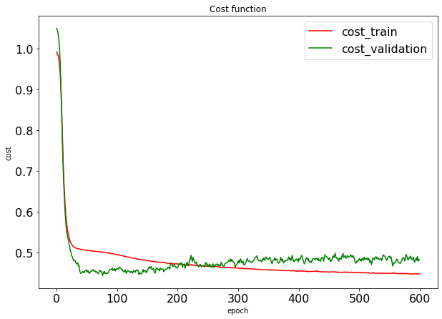
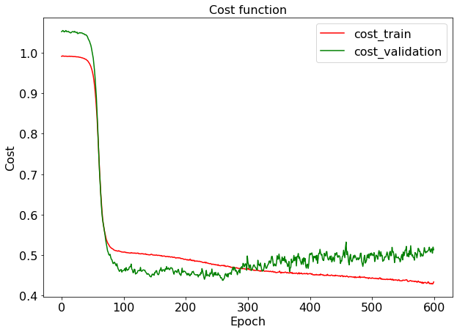
Machine 5
During learning
Overfitting
High Variance
Machine 6
During learning
Overfitting

Slide 11
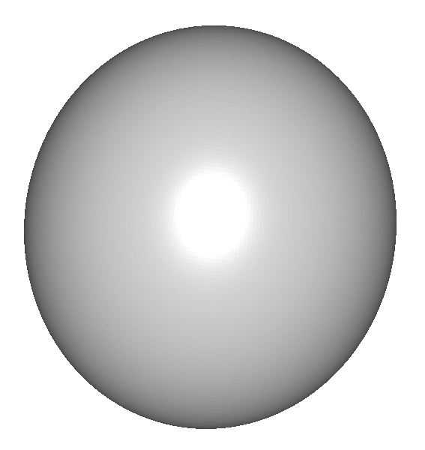
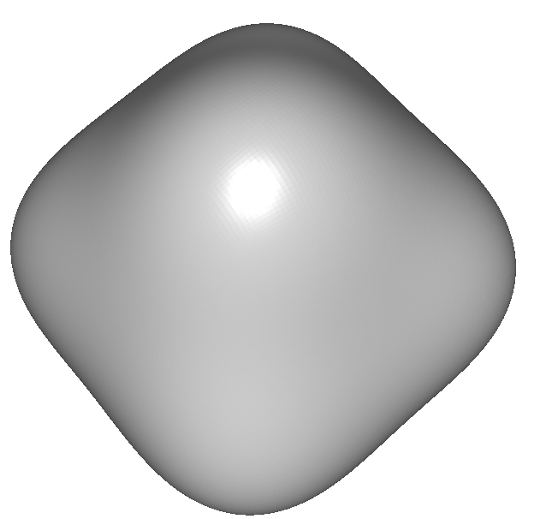
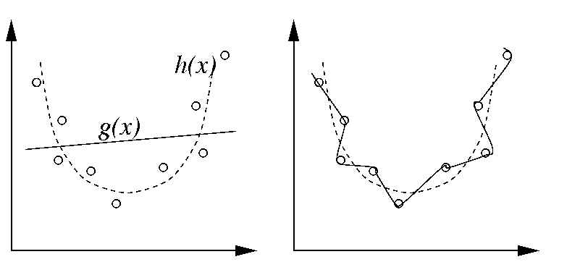
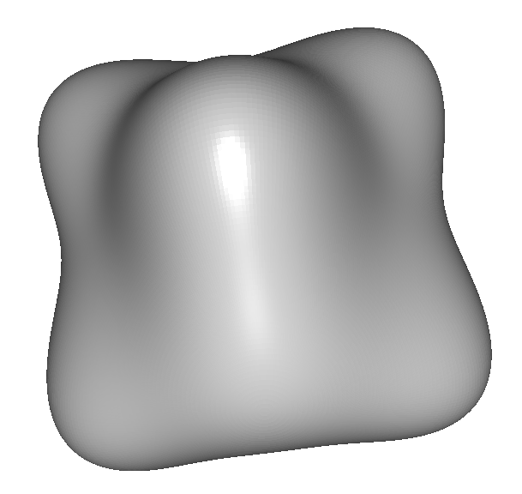
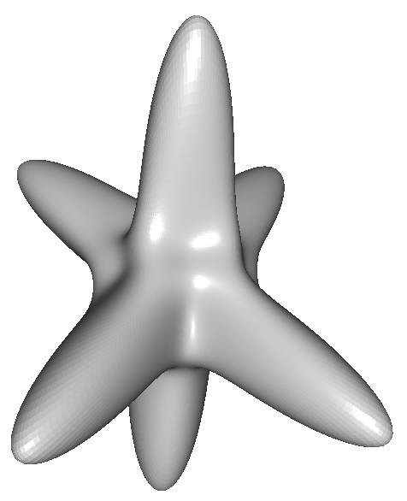
Overfitting modeling cristallite morphology
Crystallite size obtained via
Rietveld refinement.
Morphology modeled with
A summation of spherical harmonics

Slide 12
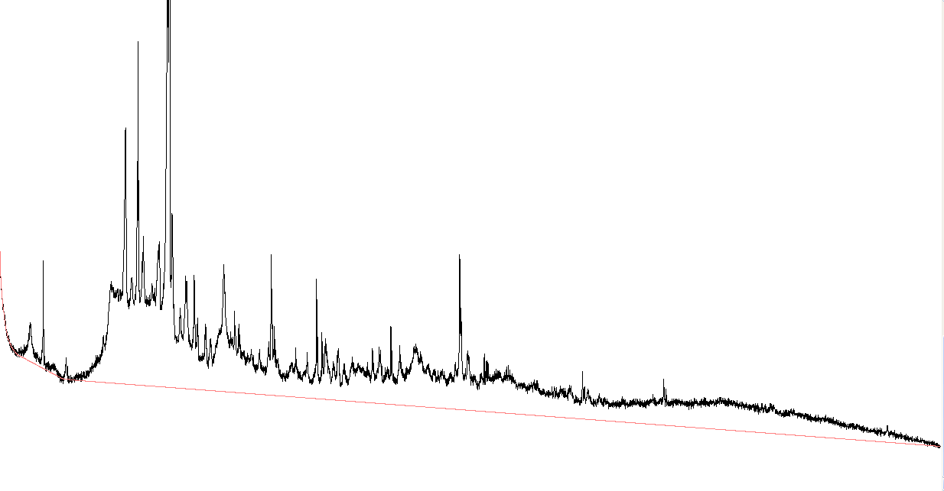
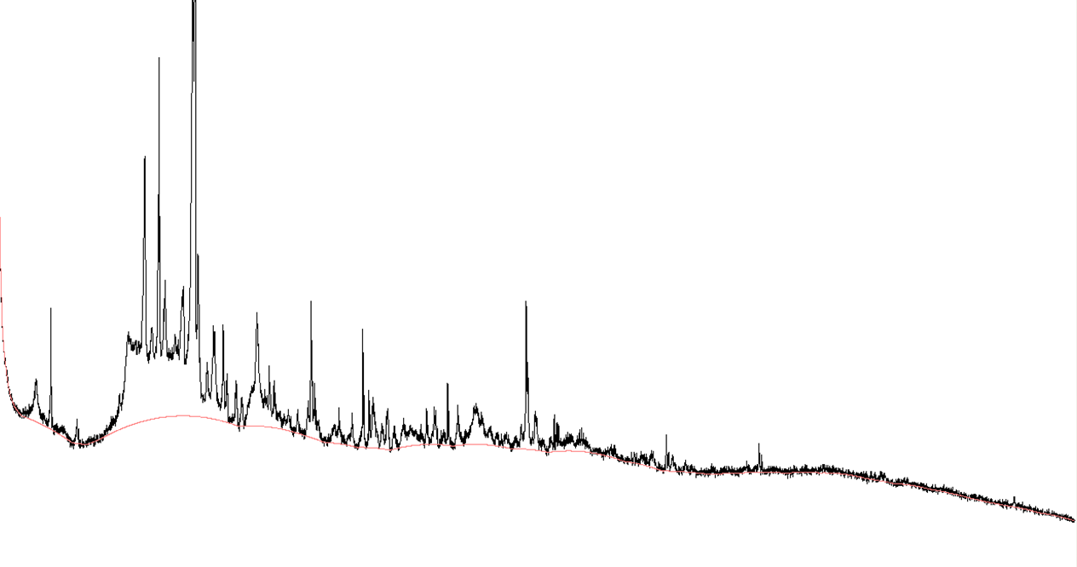
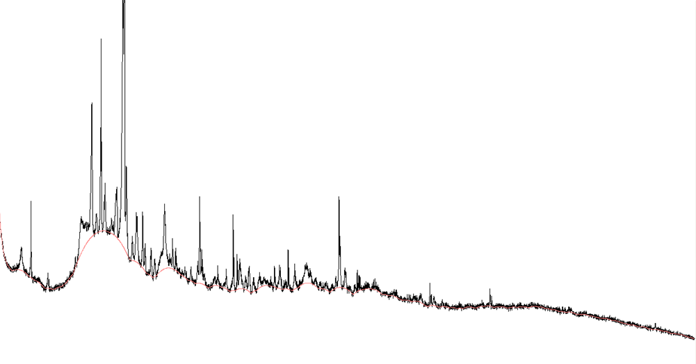
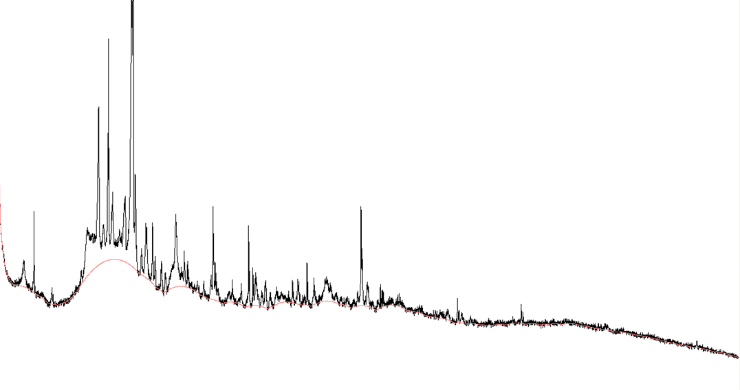
Overfitting modeling X-ray powder diffraction patterns
Background modeled with Chebyshev Polynomials

